Slide 1



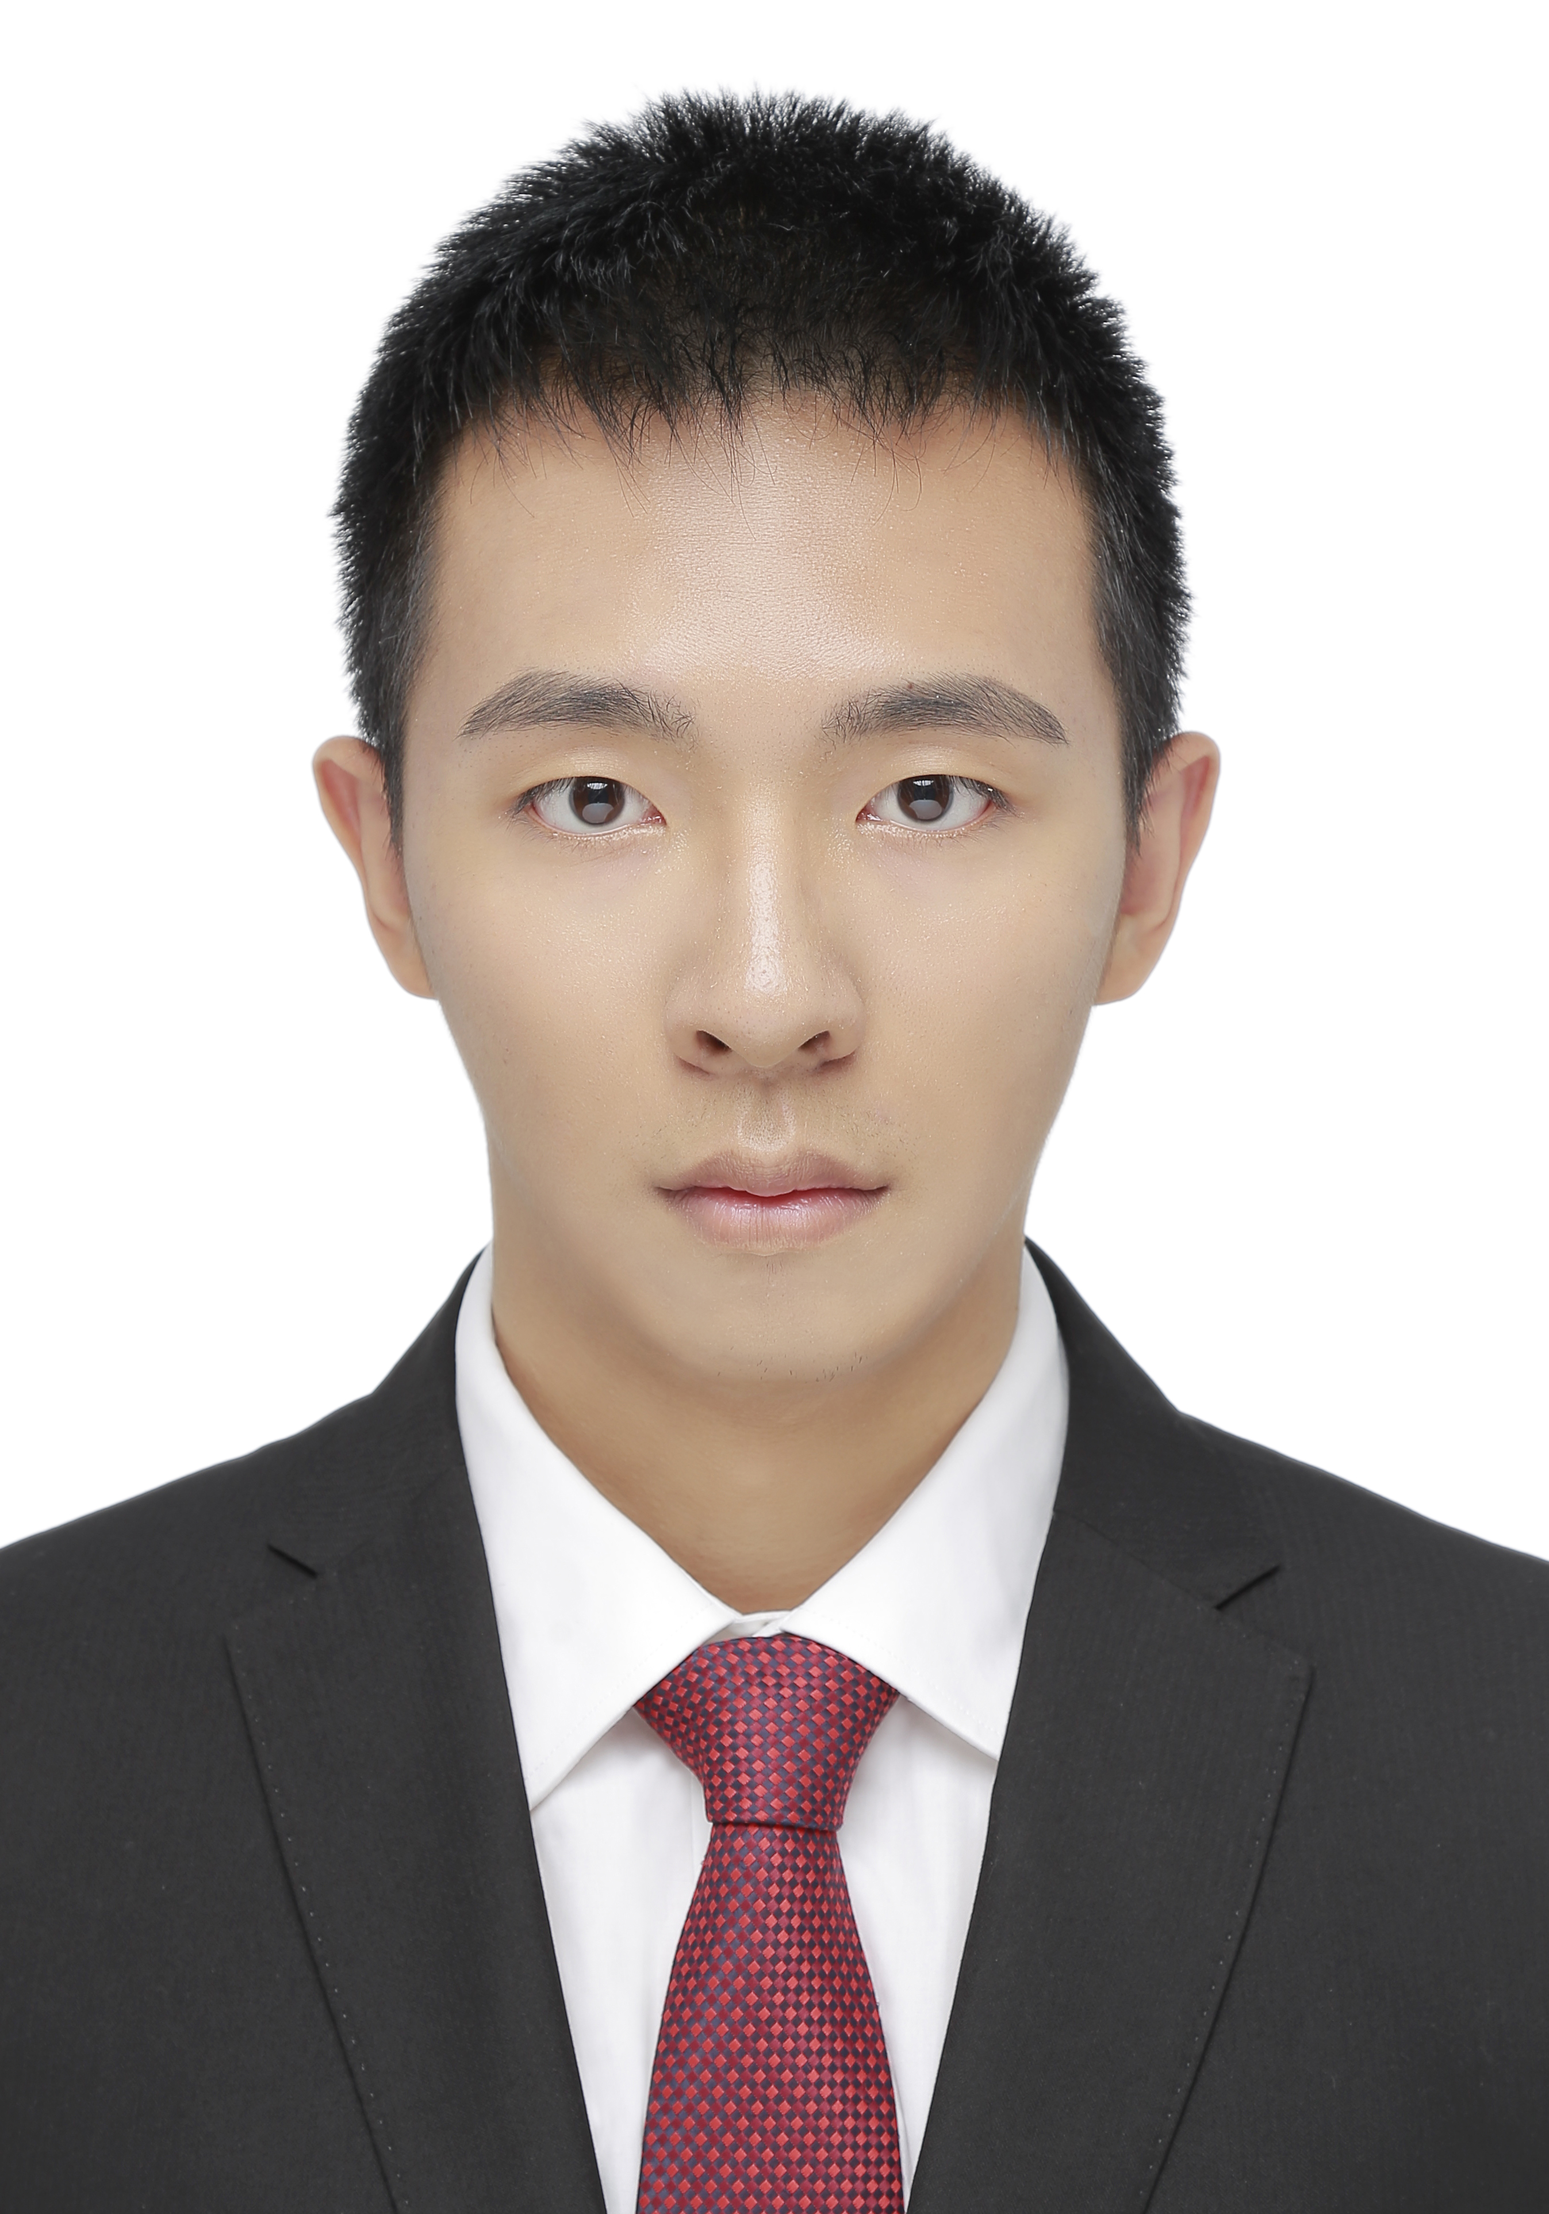
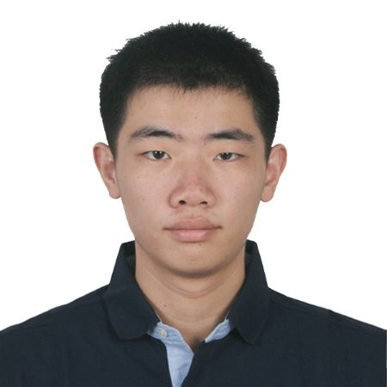

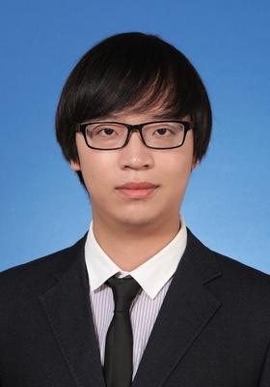

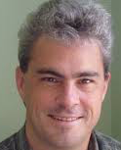

Q-BERT: Hessian Based Ultra Low Precision Quantization of BERT
Sheng Shen, Zhen Dong, Jiayu Ye, Linjian Ma, Zhewei Yao, Jiayu Ye,
Amir Gholami, Michael Mahoney, Kurt Keutzer

Slide 2


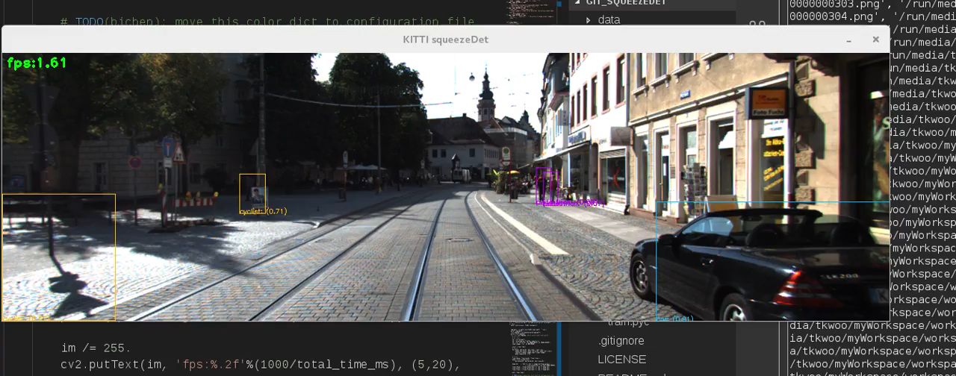
Deep Learning Revolution

Slide 3
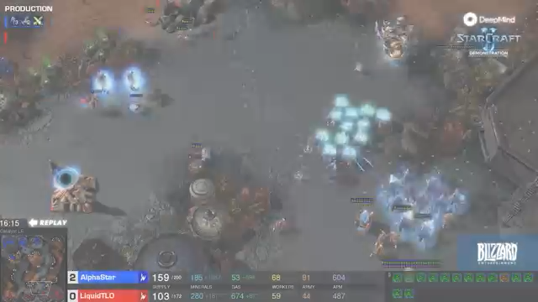
Deep Learning Revolution
Notes:
Starcraft game

Slide 4
But …
Promising results, but:
Successfully applying it for a slightly different problem is more of a dark art
Lots of “tricks” and expensive hyper-parameter tuning
Ad-hoc rules that do not generalize
Quasi-Random search methods that do not scale
Image from here

Slide 5
But …
So far industry has been able to address this by pouring massive computational power and investment:
State-of-the-art models are trained with AutoML requiring hundreds of thousands of GPU hours
A single training of RoBERTa takes 10 months on a 100K DGX system
Training AlphaStar had a cost of at about 700M USD
But this approach is not scalable

Slide 6
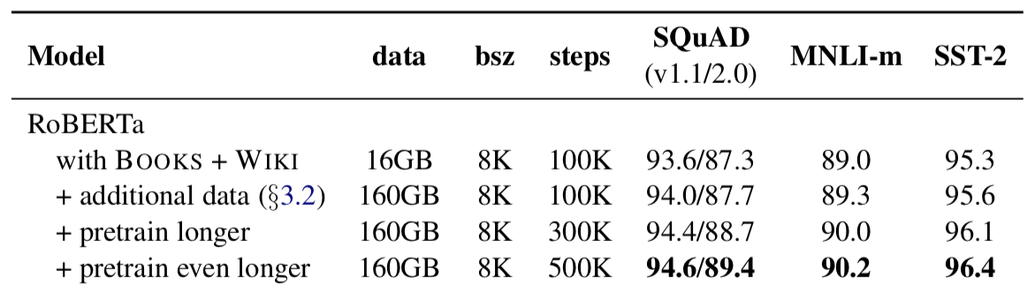
An Example
Is this enough number of steps? Why not 1M steps?
Liu, Yinhan, et al. "RoBERTa: A Robustly Optimized BERT Pretraining Approach." arXiv preprint arXiv:1907.11692 (2019).

Slide 7
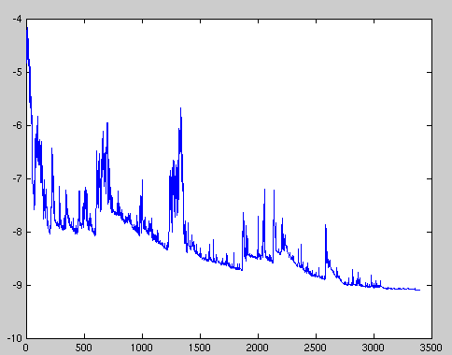
An Example
Mini-batch: compute gradient using b samples
Image Source: Hao Li UMD

Slide 8
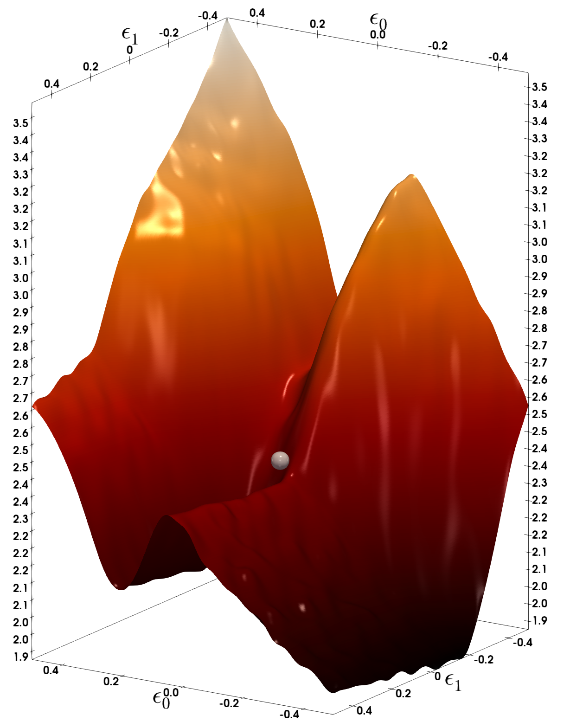
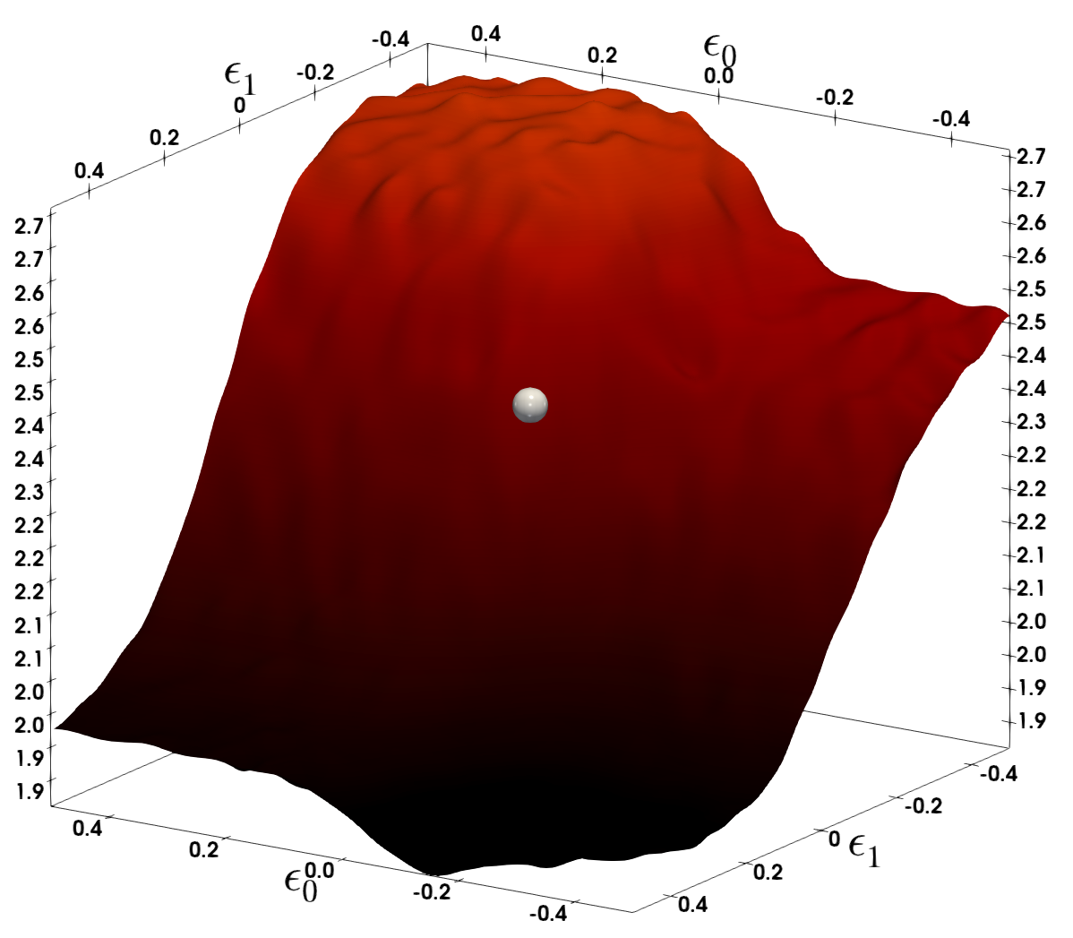
Stochastic Gradient Descent (SGD)
BERT model trained on SQuAD:
Clearly the model has not converged
Mini-batch: compute gradient using b samples
Devlin, Jacob, et al. "BERT: Pre-training of deep bidirectional transformers for language understanding." arXiv preprint arXiv:1810.04805 (2018).
S. Sheng, Z. Dong, J. Ye, L. Ma, Z. Yao, A. Gholami, M. Mahoney, K. Keutzer, Q-BERT: Hessian Based Ultra Low Precision Quantization of BERT

Slide 9
How to Compute Hessian?
Forward Pass
Backward Pass

Slide 10
How to Compute Hessian?
2nd Backward Pass
Notes:
\color{red}\frac{d^2L}{dx^2}=\frac{d^2L}{dz^2}\frac{dz}{dx}\frac{dz}{dx}^T + \frac{dL}{dz}\frac{d^2z}{dx^2}

Slide 11
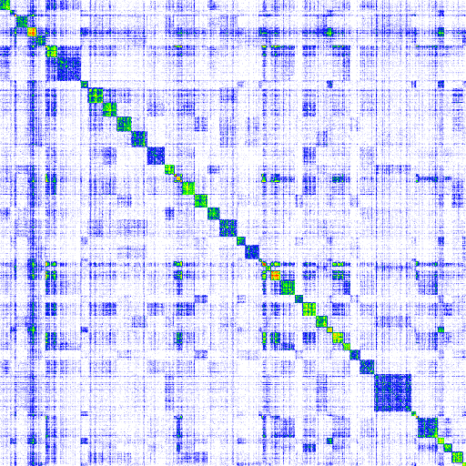
How to Compute Hessian?
Backpropogating second order information is computationally infeasible
However, we can use random linear algebra algorithms which only require the action of Hessian

Slide 12
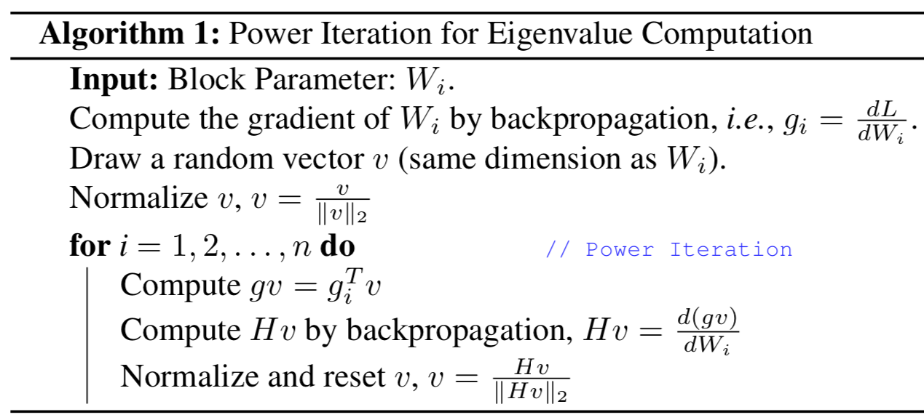
How to Compute Hessian?
Z. Yao, A. Gholami, Q. Lei, K. Keutzer, M. Mahoney. Hessian-based Analysis of Large Batch Training and Robustness to Adversaries, NeurIPS’18

Slide 13

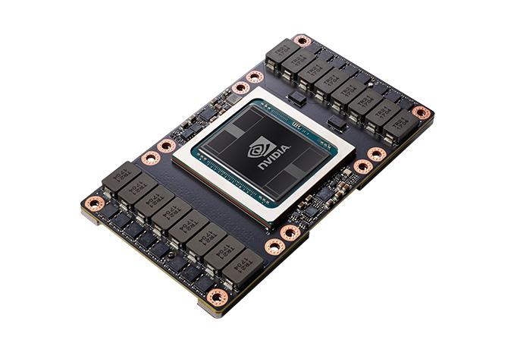
Problem Definition
Goal: Quantize a model in single precision without accuracy loss to enable efficient inference on the edge

Slide 14
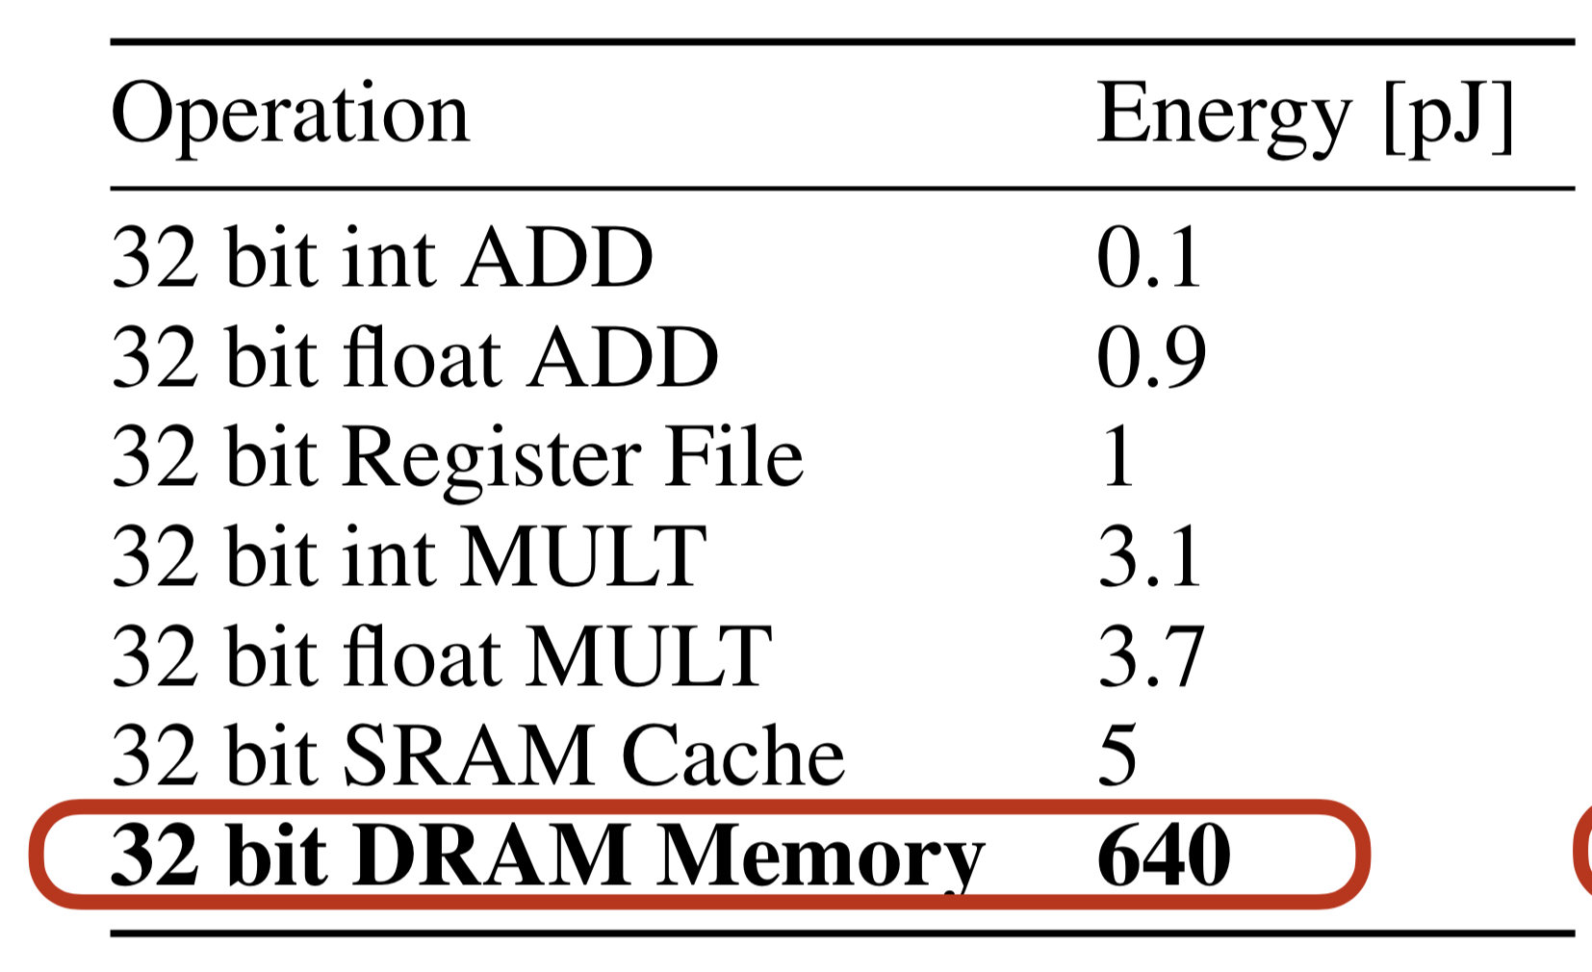
Why Quantization?
Significantly reduce memory access volume
Allows use of reduces precision ALUs -> Faster Inference
Reduce communication volume by allowing execution on embedded devices
6400x
Image from here
Table: Courtesy of S. Han
Notes:
So why is quantization a promising approach to address this?

Slide 15
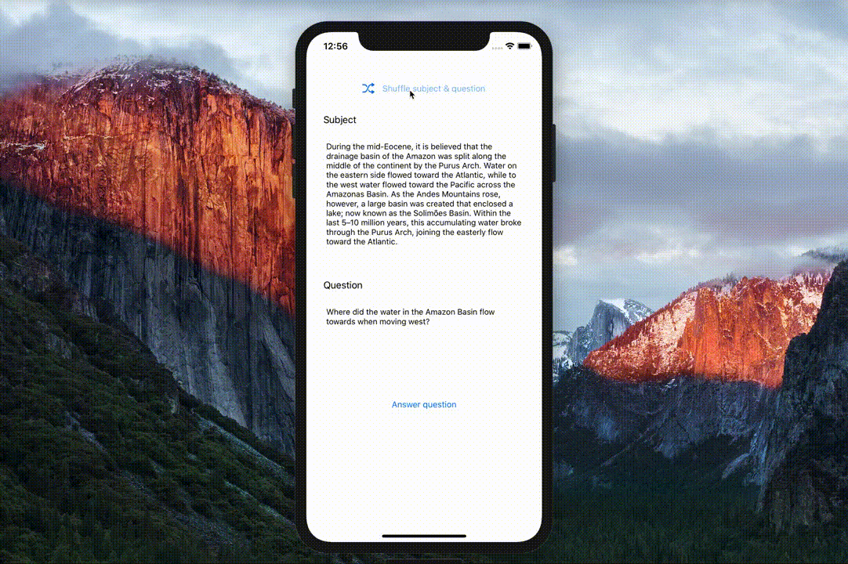

Why Quantization for NLP?
On-device NLP systems are needed, which may only support low-bit precision.
Faster Inference at the edge is on demand.
Image from here
Notes:
Always the motivation, why should we do quantization for BERT or generally Big Natural Language Processing Model.
The reasons might be simple, we all know natural language processing model such as Language Model, QA, NMT benefit us usual life a lot, like LM to suggest next word in keyboard, or Google MT to translate nearly every language you like. But what if some people have limited access to the network, they may still want to leverage (say not perfect but reasonable) models. That’s when people need these model to be deployed in their small devices like phones.
In order to do that, we need at least compress the Big model to make it compatible for these devices.
That’s pretty much why we want to do the quantization here.

Slide 16
Quantization Dark Art
Quantization is a very promising approach but:
Very hard to get right for a new model/dataset
Lots of “tricks” and expensive hyper-parameter tuning
Ad-hoc rules that do not generalize
Image from here

Slide 17
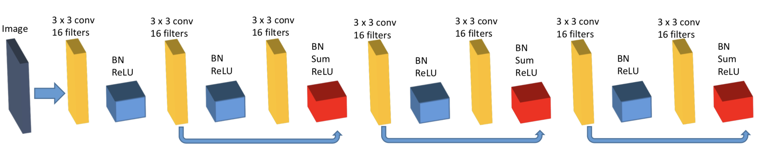
Mixed-Precision: Exponential Search Space
8-bit
4-bit
4-bit
2-bit
2-bit
4-bit
8-bit
2-bit
2-bit
4-bit
Which mixed-precision setting works better?

Slide 18
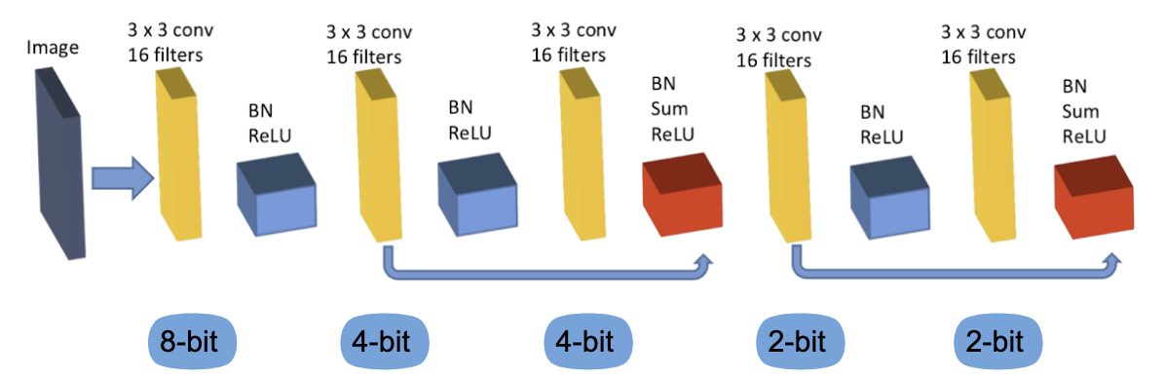
Hessian Based Mixed Precision
Only quantize layers to ultra-low precision that have small Hessian spectrum

Slide 19
HAWQ-V1: Provide Relative Weight Precision
Only quantize layers to ultra-low precision that have small Hessian spectrum
Z. Dong, Z. Yao, A. Gholami, M. Mahoney, K. Keutzer, HAWQ: Hessian Aware Quantization of Neural Networks With Mixed Precision, ICCV’19 (Accepted)

Slide 20
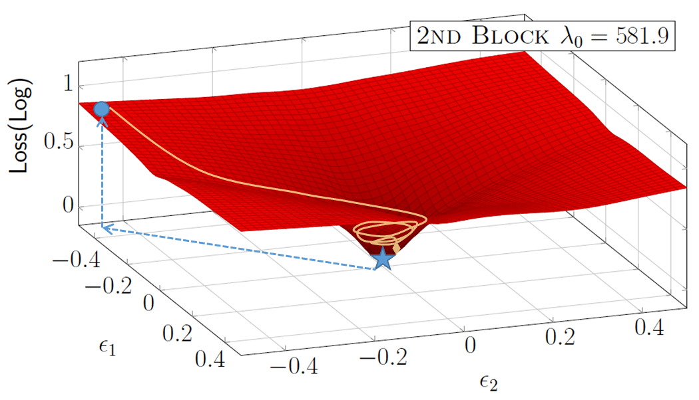
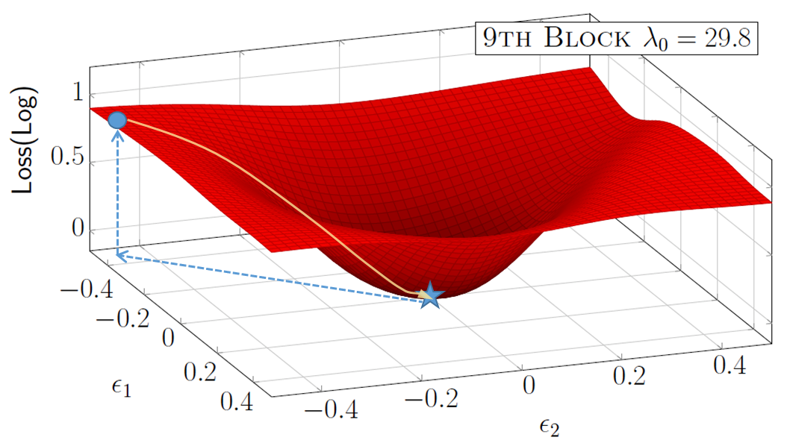
Intuition for HAWQ-V1
Zeroth vs. 2nd order sensitivity analysis
Zeroth Order Sensitivity: 0.1 -> 0.8
Top Eigenvalue = 581.9:
Bad for Quantization-Aware Fine-tuning
Zeroth Order Sensitivity: 0.1 -> 0.9
Top Eigenvalue = 29.8:
Good for Quantization-Aware Fine-tuning
Z. Dong, Z. Yao, A. Gholami, M. Mahoney, K. Keutzer, HAWQ: Hessian Aware Quantization of Neural Networks With Mixed Precision, ICCV’19 (Accepted)
Notes:
One thing need to mention here is that we use Quantization-aware finetuning, it means the weight will change along with quantization.
Zeroth order here means we directly perturb the weight such that the model ends with the location with same loss. But for the left case, the local mimia is actually too sharp makes it bad for Quantization-Aware Fine-tuning, while the right case is much more flatten and good for Quantization-Aware Fine-tuning.
This information can be directly inferred with second–order information, that pretty much demonstrates the motivation why we need to look at the hessian to measure the sensitivity difference across the layers.

Slide 21
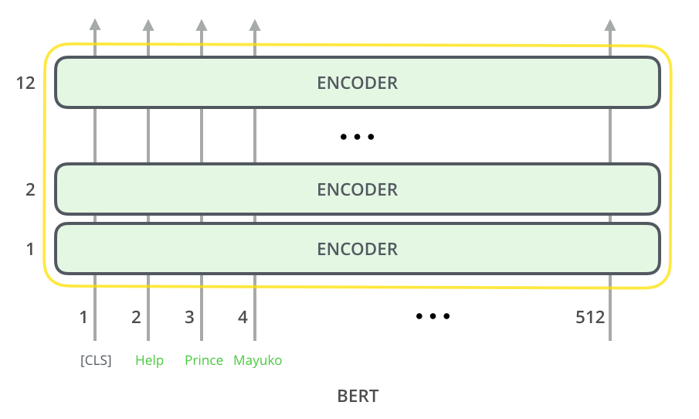
Natural Language Processing
BERT based models have become de-facto architecture for NLP tasks
BERT-base: 12 Layer, 12 Heads, 768 Hidden Dim (110M param, 415MB)
BERT-large: 24 Layer, 16 Heads, 1024 Hidden Dim (340M param, 1297MB)
Devlin, Jacob, et al. "BERT: Pre-training of deep bidirectional transformers for language understanding." arXiv preprint arXiv:1810.04805 (2018).
Notes:
Before BERT, people design different model for various tasks, which requires different complex structures for each task.
But people recently found that, by improving the representation power of words with large pretrained model, we can have rather simple structure on top of that and achieve even better performance on many downstream taks.
But this is not a silver bullet, the accompanied memory issue should not be ignored.
You can see even for BERT-base, we need to store at least 100M parameters, which may take up 400 MB storage. For BERT-large, the things become even worse. We need around 1.3GB for storage.

Slide 22
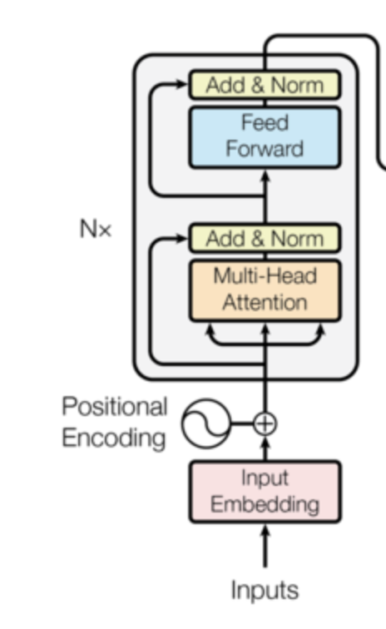
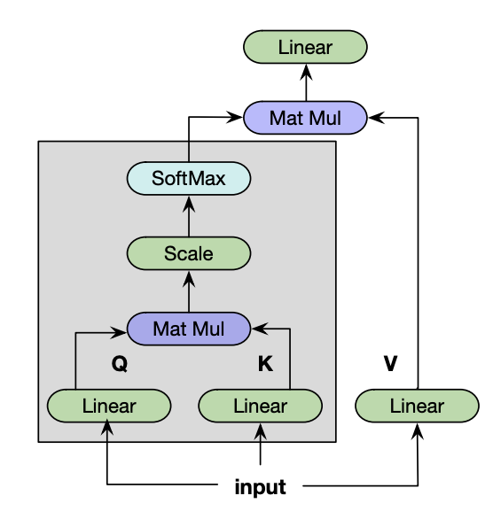
Natural Language Processing
BERT encoder consists of Multihead Self-Attention & Fully-Connected Layer
Weight (W) in MSA will be first split for computation then concat for output.
xh
(a) BERT Encoder [Transformer]
(b) Self-attention
Attention(Q,K,V) = softmax(Q*K/(d^0.5))*V Att(X,X,X) = softmax(X*W^{Q}*(X*W^{K})^{T}/(d^0.5))*X*W^{V}
(c) Multi-head self-attention
MultiHead(Q,K,V) = Concat(head₁,...,head_{h})W_{O}
where head_{i} = Attention(QW^{Q}_{i}, KW^{K}_{i},VW^{V}_{i})
Devlin, Jacob, et al. "BERT: Pre-training of deep bidirectional transformers for language understanding." arXiv preprint arXiv:1810.04805 (2018).

Slide 23
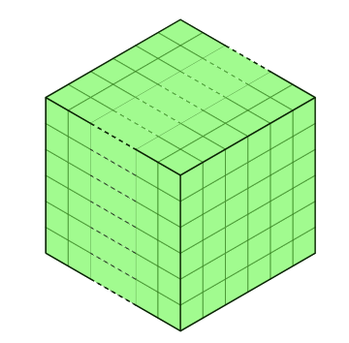
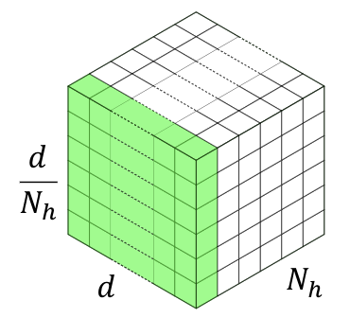
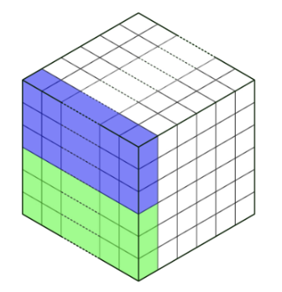
Natural Language Processing
Weight (W) in MSA will be first split into N_{h} (#head) pieces for computation.
Layer-wise quantization is suboptimal: quantize W as an entirety.
Group-wise quantization: bucket consecutive neurons together for quantization.
(a) Layer-wise
(b) Group-wise (N_{h} group)
(c) Group-wise (2*N_{h} group)
S. Sheng, Z. Dong, J. Ye, L. Ma, Z. Yao, A. Gholami, M. Mahoney, K. Keutzer, Q-BERT: Hessian Based Ultra Low Precision Quantization of BERT
Notes:
Directly quantizing each 4 matrices in MHSA as an entirety with the same quantization
range can significantly degrade the accuracy, since there are more than 2M parameters in total, which corresponds to
4×12×64 = 3072 neurons, and the weights corresponding to each neuron may lie in different range of
real numbers.
We treat the individual matrix W with respect to each head in one dense matrix of MHSA as a group so there will be 12 groups. Furthermore, in each group, we bucket sequential output
neurons together as sub-groups, e.g., each 6 output neurons as one sub-group so there are 12×64/6= 128 sub-group in total (the hidden dimension in each head of BERT BASE is 768/12 = 64)

Slide 24
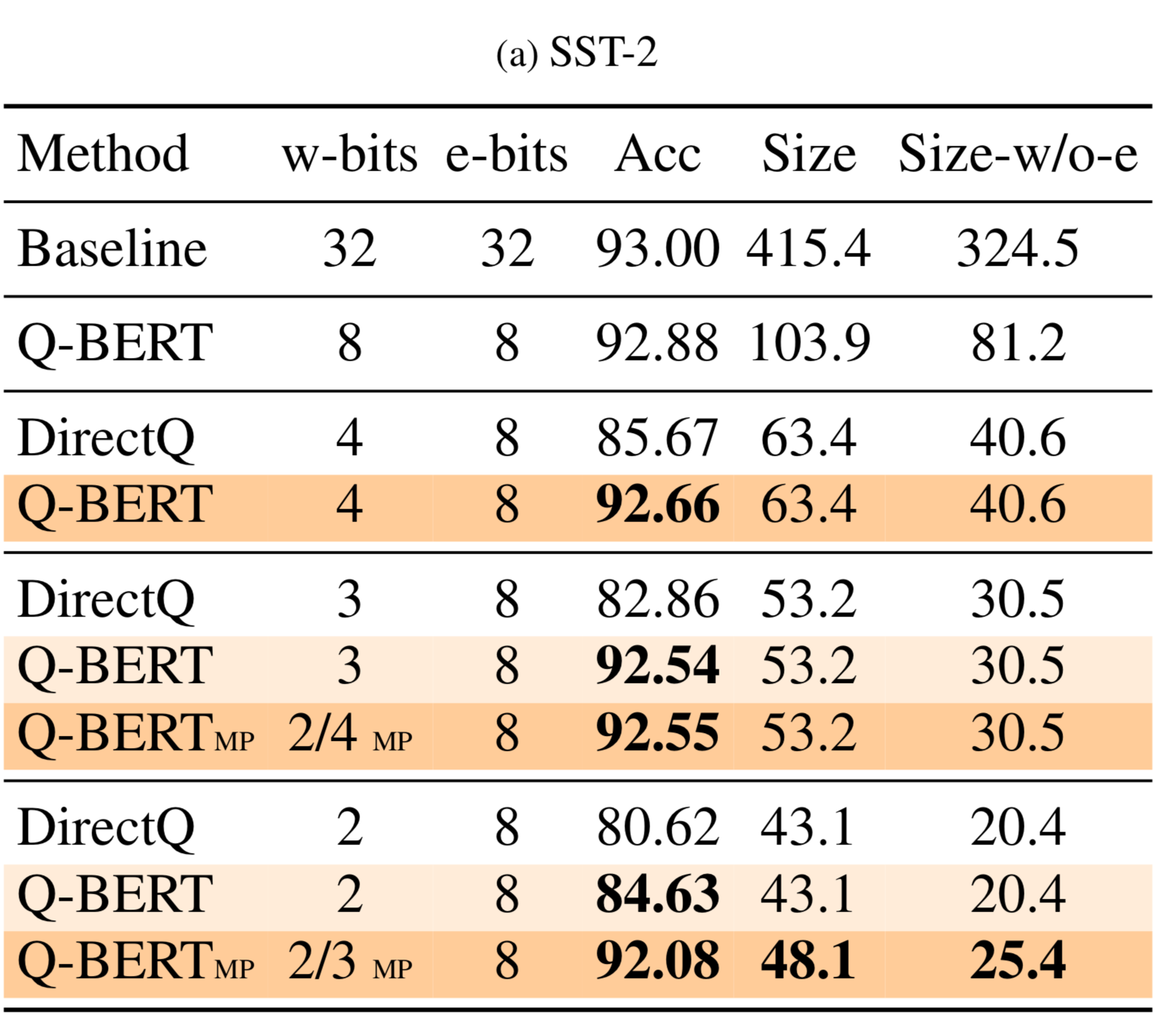
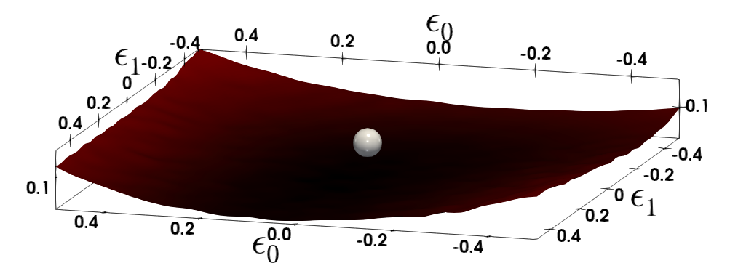
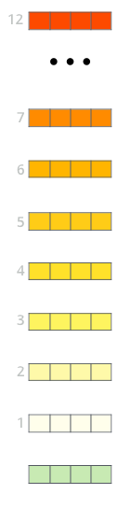
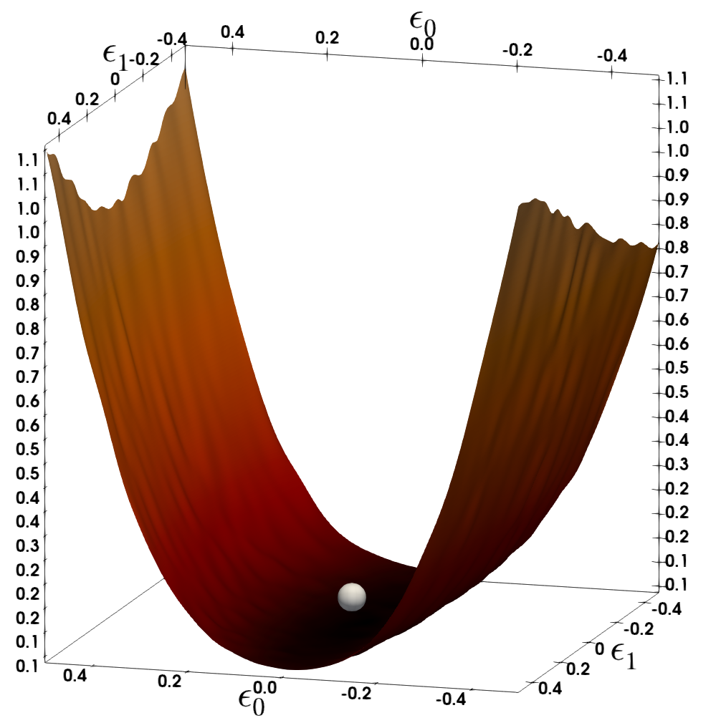
Stanford Sentiment Treebank
10th Layer
3rd Layer
S. Sheng, Z. Dong, J. Ye, L. Ma, Z. Yao, A. Gholami, M. Mahoney, K. Keutzer, Q-BERT: Hessian Based Ultra Low Precision Quantization of BERT
Notes:
The loss landscape for different layers in MNLI and CoNNL-03 is illustrated by perturbing the parameters along the first two dominant
eigenvectors of the Hessian. The silver sphere shows the point in the parameter space to which the BERT model has converged. Layers that exhibit
flatter curvature can be quantized to lower bit precision
One consideration for quantization is that 3-bit quantized execution is typically not supported in hardware. It is however
possible to load 3-bit quantized values and cast them to higher bit precision such as 4 or 8 bits in the execution units.
This would still have the benefit of reduced memory volume to/from DRAM. It is also possible to avoid using 3 bits and
instead use a mixture of 2 and 4 bits as shown in Tab. 1. For example, SST-2 Q-BERTMP
with mixed 2/4-bit precision weights has the same model size as the 3 bit quantization in 53.2MB and achieves similar accuracy. We observe a similar
trend for other tasks as well.

Slide 25
Stanford Sentiment Treebank
10th Layer
3rd Layer
S. Sheng, Z. Dong, J. Ye, L. Ma, Z. Yao, A. Gholami, M. Mahoney, K. Keutzer, Q-BERT: Hessian Based Ultra Low Precision Quantization of BERT
Notes:
The loss landscape for different layers in MNLI and CoNNL-03 is illustrated by perturbing the parameters along the first two dominant
eigenvectors of the Hessian. The silver sphere shows the point in the parameter space to which the BERT model has converged. Layers that exhibit
flatter curvature can be quantized to lower bit precision
One consideration for quantization is that 3-bit quantized execution is typically not supported in hardware. It is however
possible to load 3-bit quantized values and cast them to higher bit precision such as 4 or 8 bits in the execution units.
This would still have the benefit of reduced memory volume to/from DRAM. It is also possible to avoid using 3 bits and
instead use a mixture of 2 and 4 bits as shown in Tab. 1. For example, SST-2 Q-BERTMP
with mixed 2/4-bit precision weights has the same model size as the 3 bit quantization in 53.2MB and achieves similar accuracy. We observe a similar
trend for other tasks as well.

Slide 26
Stanford Sentiment Treebank
10th Layer
3rd Layer
S. Sheng, Z. Dong, J. Ye, L. Ma, Z. Yao, A. Gholami, M. Mahoney, K. Keutzer, Q-BERT: Hessian Based Ultra Low Precision Quantization of BERT
Notes:
The loss landscape for different layers in MNLI and CoNNL-03 is illustrated by perturbing the parameters along the first two dominant
eigenvectors of the Hessian. The silver sphere shows the point in the parameter space to which the BERT model has converged. Layers that exhibit
flatter curvature can be quantized to lower bit precision
Beyond the relatively smaller mean, the last three layers also have
much smaller variance, which indicates the insensitivity of these layers. Therefore, higher bits will only be assigned for
middle layers according to Eq. 3.2 for
Q-BERT 2/3
MP
t. We can obverse that for most of the
lower encoder layers (layer 1-8), the variance is pretty large compared to the last three layers. We generally observe that
Q-BERT: Hessian Based Ultra Low Precision Quantization of BERT
7
the middle part (layer 4-8) has the largest
mean
(
λ
i
)
In this way, with only additional 5MB memory storage, 2/3-bits
Q-BERT
MP
is able to retain the performance drop within 2.3% for MNLI, SQuAD and 1.1% for SST-2, CoNLL-03, with
up to
13
×
compression ratio in weights. Note that this is up to 7% better than Q-BERT with uniform 2 bits

Slide 27
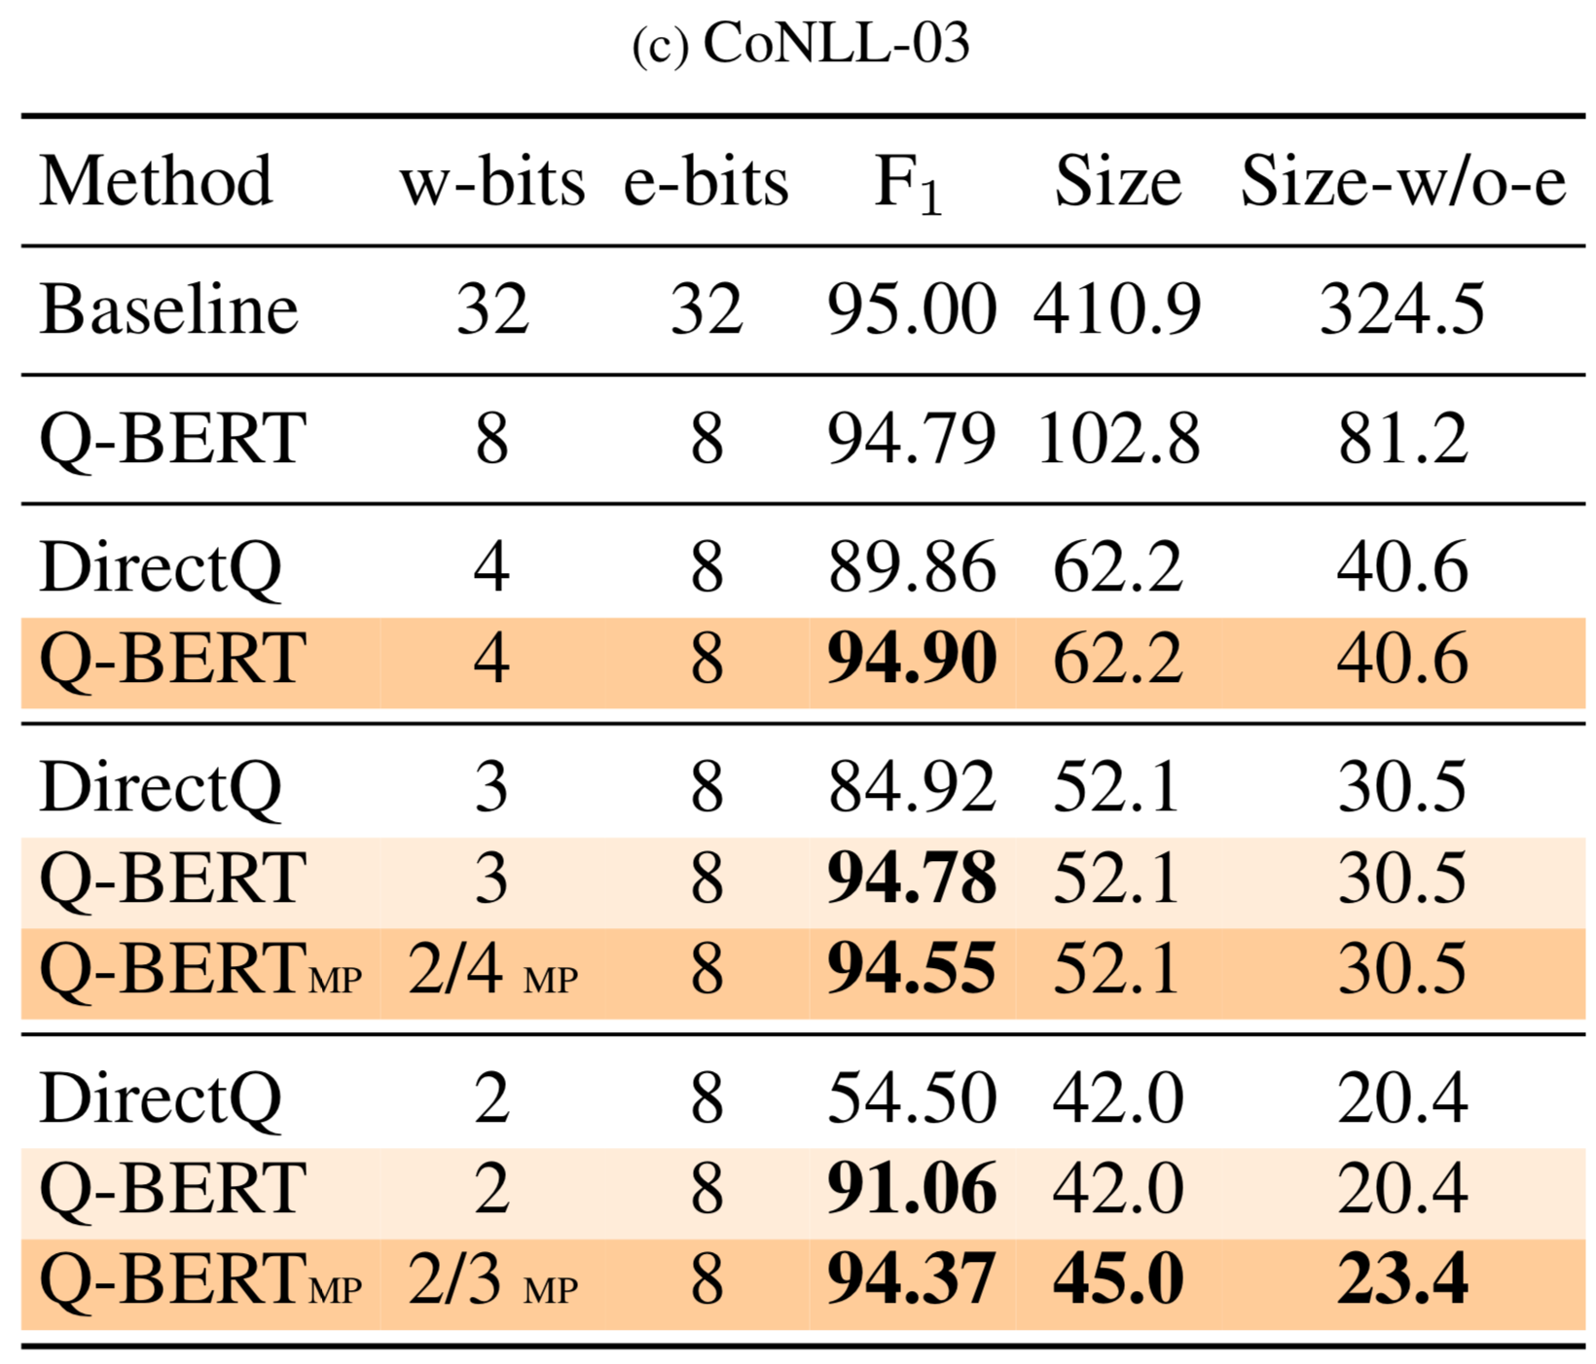
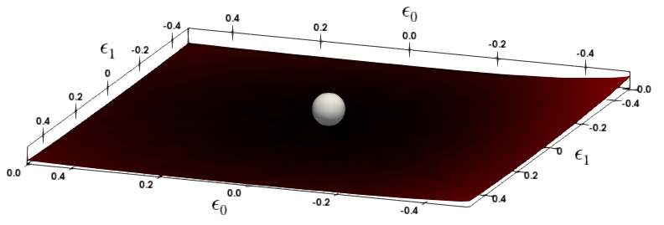
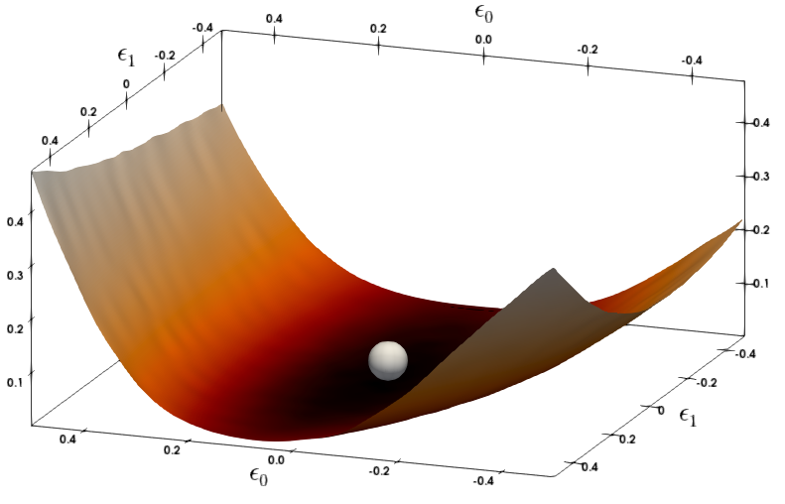
Natural Language Processing
11th Layer
7th Layer
S. Sheng, Z. Dong, J. Ye, L. Ma, Z. Yao, A. Gholami, M. Mahoney, K. Keutzer, Q-BERT: Hessian Based Ultra Low Precision Quantization of BERT

Slide 28
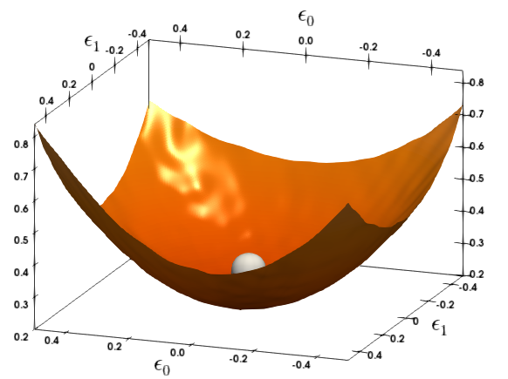
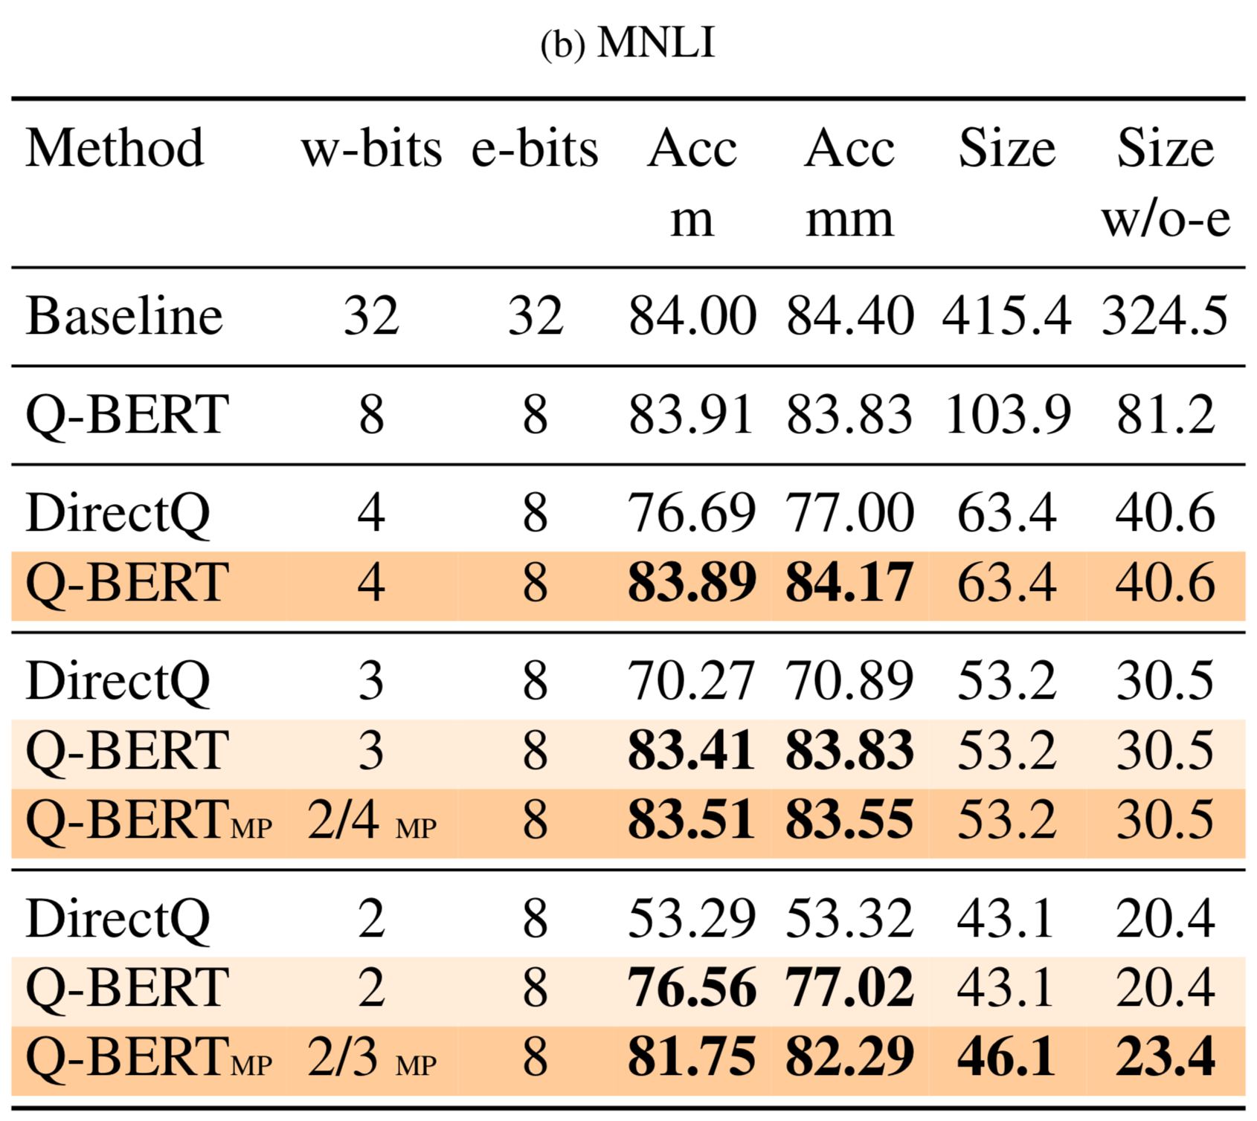
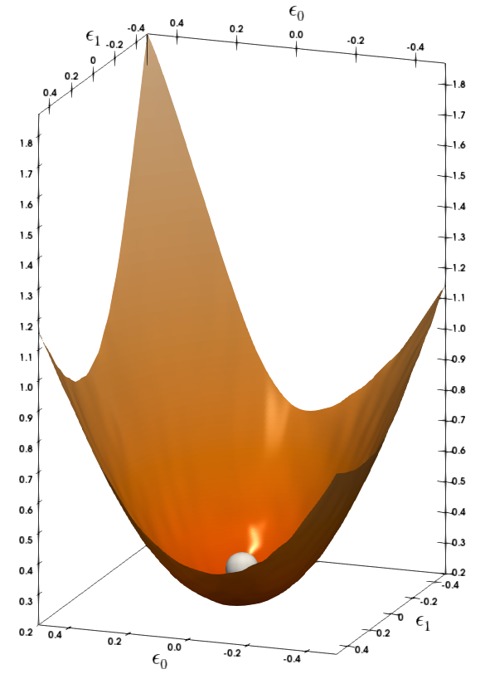
Natural Language Processing
10th Layer
4th Layer
S. Sheng, Z. Dong, J. Ye, L. Ma, Z. Yao, A. Gholami, M. Mahoney, K. Keutzer, Q-BERT: Hessian Based Ultra Low Precision Quantization of BERT

Slide 29
Span Level Question Answering (SQuAD)
SQUAD Examples:
Input Question?
Where do water droplets collide with ice crystals to form precipitation?
Input Paragraph:
.... Precipitation forms as smaller droplets coalesce via collision with other rain dropsor ice crystals within a cloud. ...
Output Answer:
within a cloud
Evaluation Metric: F1 score/ Exact Match
Predict: “crystals within a cloud”
F1: 0.8 (split into token level match. TP as correct predicted tokens.)
EM: 0
S. Sheng, Z. Dong, J. Ye, L. Ma, Z. Yao, A. Gholami, M. Mahoney, K. Keutzer, Q-BERT: Hessian Based Ultra Low Precision Quantization of BERT

Slide 30
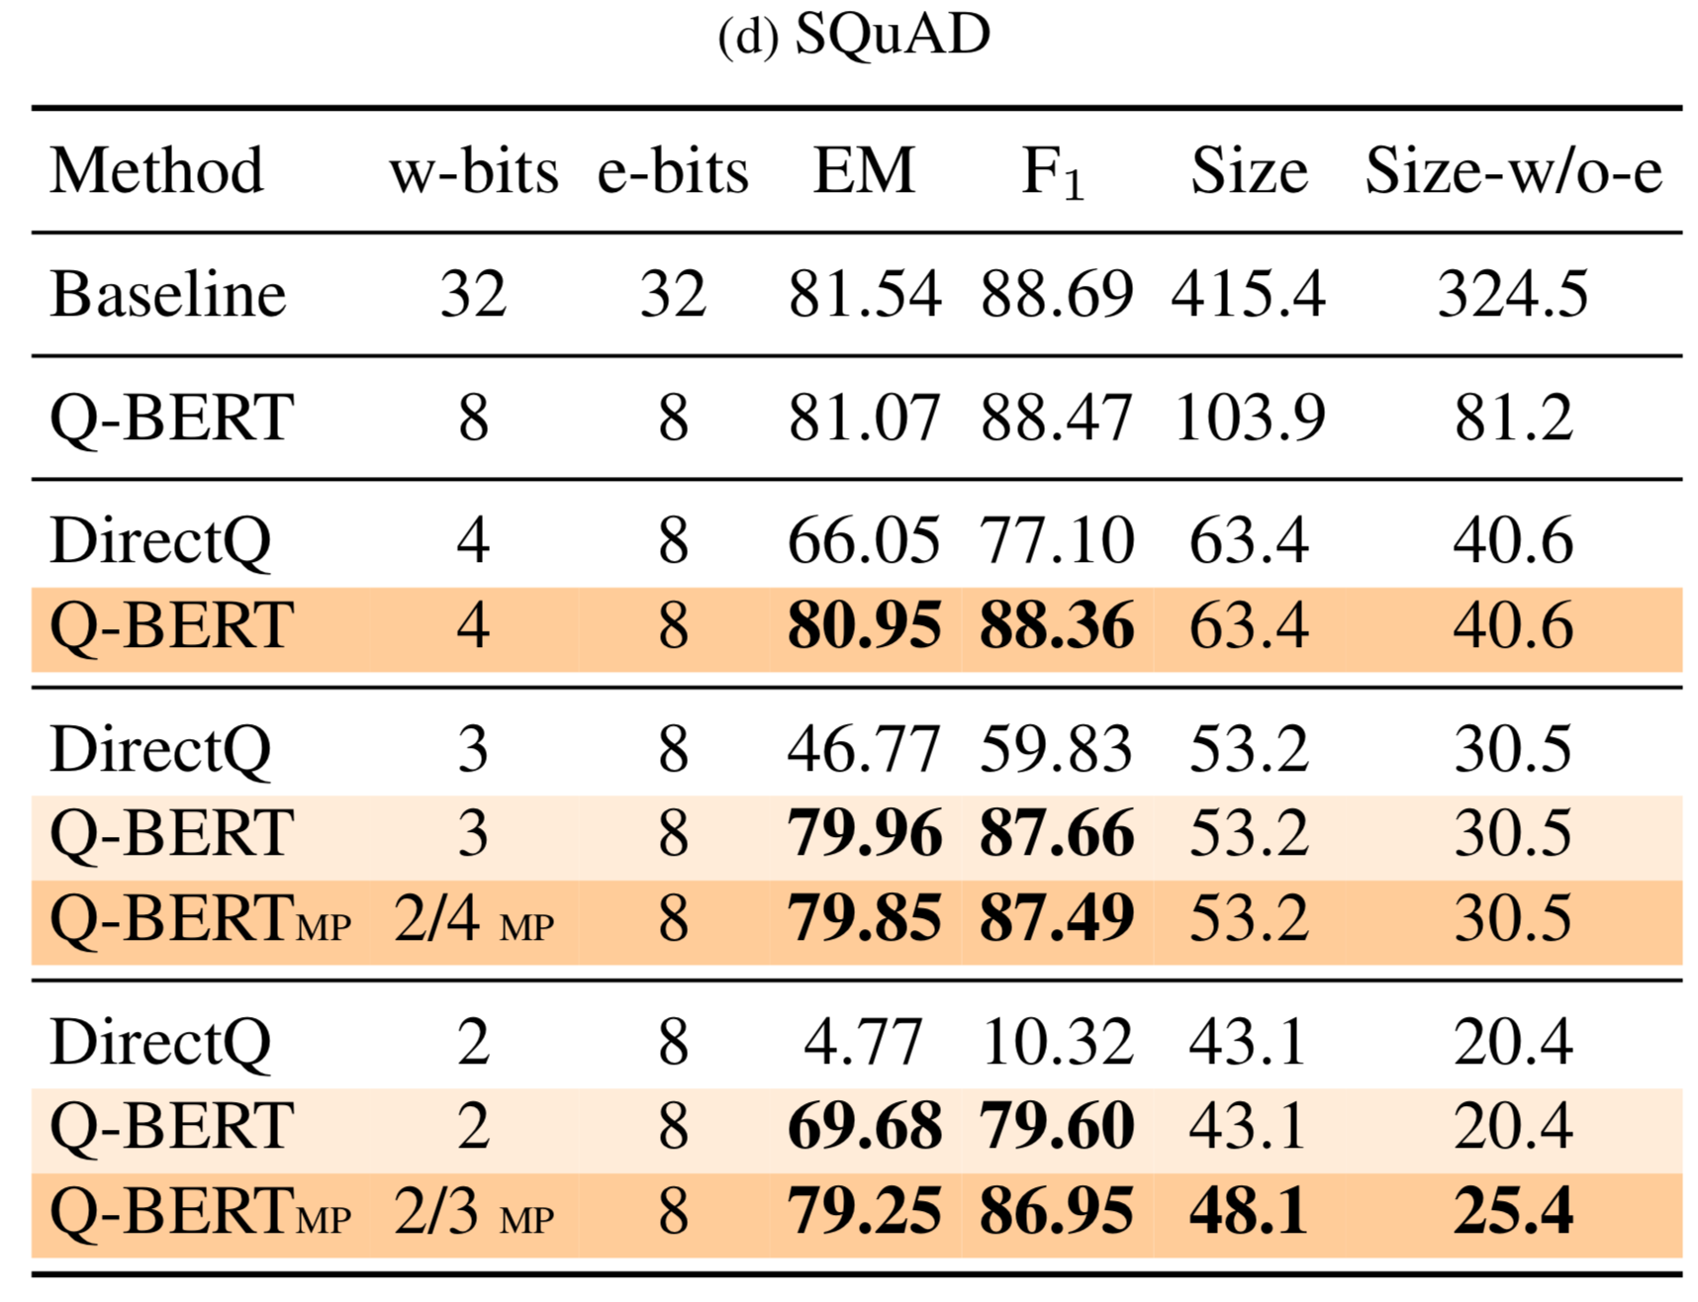
Natural Language Processing
11th Layer
7th Layer
S. Sheng, Z. Dong, J. Ye, L. Ma, Z. Yao, A. Gholami, M. Mahoney, K. Keutzer, Q-BERT: Hessian Based Ultra Low Precision Quantization of BERT
Notes:
One important observation is that we found SQuAD to be harder to quantize as compared to other tasks; see Tab. 1d.
For example, 2-bits DirectQ results in only 10% F
1
score. Even Q-BERT has larger performance drop as compared to
other tasks in Tab. 1. We studied this phenomenon further through Hessian analysis. In Fig. 2, among all the tasks, it
can be clearly seen that SQuAD not only has much larger eigenvalue variance, but it has very large negative eigenvalues.
In fact this shows that the existing BERT model for SQuAD has not reached a local minima. This is further illustrated
in the 3-d loss landscape of all four tasks in Fig. 1 and Fig. 3 (and Fig. 6 in Appendix). It can be clearly seen that for
the other three tasks, the stopping point is at a quadratic bowl (at least in the first two dominant eigenvalue directions of
the Hessian). However, compared to the others, SQuAD has a totally different structure to its loss landscape. As shown
in Fig. 3, the stopping points of different layers on SQuAD have negative curvature directions, which means they have not
converged to a local minima yet. This could well explain why the quantization of SQuAD results in more accuracy drop.
Our initial attempts to address this by changing training hyper-parameters were not successful.

Slide 31
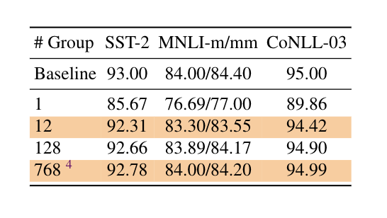
Natural Language Processing
Effect of Group-wise Quantization
Marginal Effect for improving performance with larger group number
S. Sheng, Z. Dong, J. Ye, L. Ma, Z. Yao, A. Gholami, M. Mahoney, K. Keutzer, Q-BERT: Hessian Based Ultra Low Precision Quantization of BERT
Notes:
We measure the performance gains with different group numbers in Tab. 2.
We can observe from the table that performing layer-wise quantization (shown in Fig. 4a) is sub-optimal for all three
tasks (the performance drop is around 7% even with 4-bits weights). However, the performance significantly increases
as we increase the number of groups. For example, in the case with 12 groups, the performance degradation is less
than 1% for all the tasks. Further increasing the group number from 12 to 128 increases the accuracy by at least 0.3%
accuracy. However, increasing the group number further from 128 to 768 can only increase the performance within 0.1%.
This shows that the performance gain saturates with group number 128, and we should note that the saturation group
number can potentially be even smaller, such as 12, with less aggressive quantization. It is also preferable not to have very
large value for the number of group since it increases the number of Look-up Tables (LUTs) necessary for each matrix
multiplication.

Slide 32
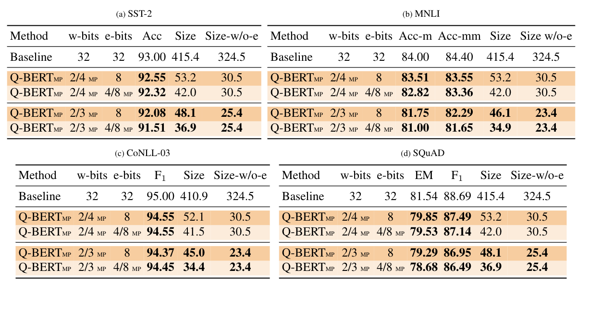
Natural Language Processing
Mixed Precision Quantization for embedding
Group-wise + Position(8)/Word(4) Embedding
Overall 11x compression ratio, 13x compression ratio w/o embedding
S. Sheng, Z. Dong, J. Ye, L. Ma, Z. Yao, A. Gholami, M. Mahoney, K. Keutzer, Q-BERT: Hessian Based Ultra Low Precision Quantization of BERT

Slide 33
Thank You for Listening!

Slide 34
Close Window
Microphone
Close nearby vents

